Slide 1
<number>
Appeals
Notes:
Appeals is a feature that allows location or level managers to request changes to responses on specific questions in individual shops.

Slide 2
<number>
Overview:
Appeals (Question level change request)
More configurability than original CR

Slide 3
<number>
Initial Project Set up
Enable Q-Level CR for client
Enable for survey
Define permissions/ notifications
Define Q Eligibility
Add CR Widget to Cham Shop View
Notes:
In the client settings, you will enable the feature. It is a premium feature that incurs a cost, so only admins with Premium access can enable this feature for a client.

Slide 4
<number>
Enable Appeals
Notes:
After the feature is enabled in the Client settings, you can go to the setup direct from Client settings, or from the main admin page using quick jump. There, choose the client and enable for a survey.

Slide 5
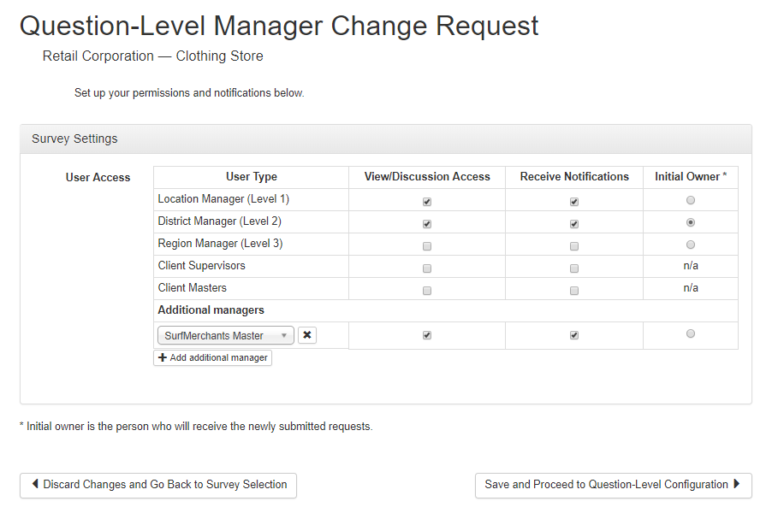
<number>
Define Perms/Notifications
Notes:
For each hierarchy level, you can choose whether the managers will have access to see and comment on the requests, get notifications about updates to requests, and you will choose which level of manager is the initial owner, the user who the request is sent to when first created.
You can also add Additional Managers here.

Slide 6
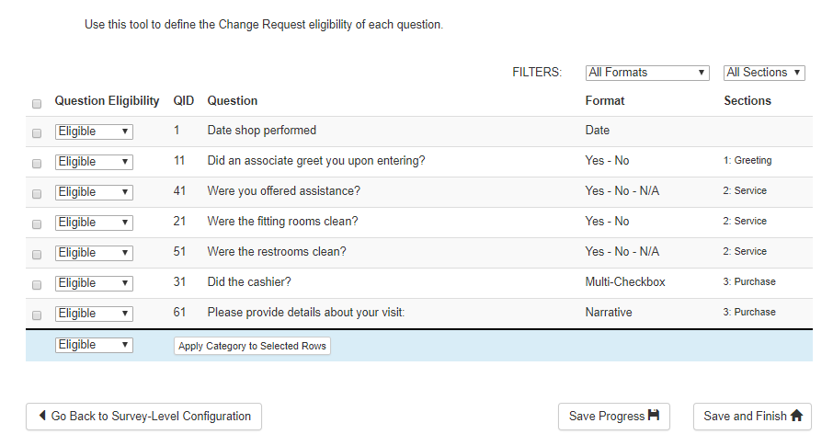
<number>
Define Question Eligibility
* All questions default to Eligible
Notes:
If you want to make certain questions ineligible for requests, modify the eligibility here.

Slide 7
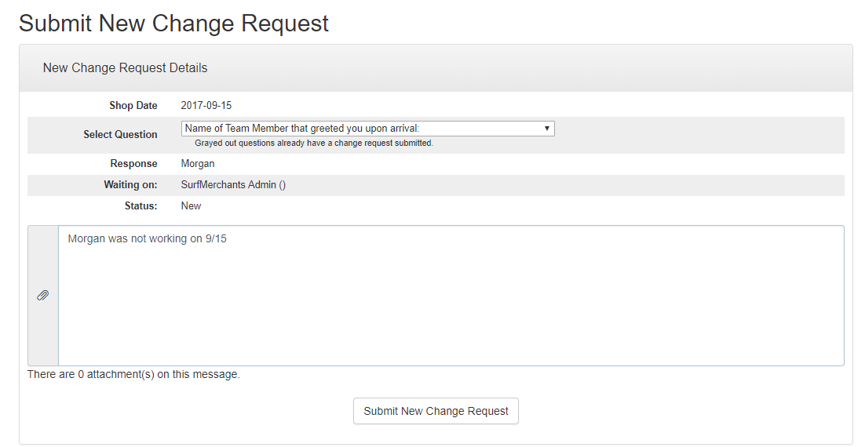
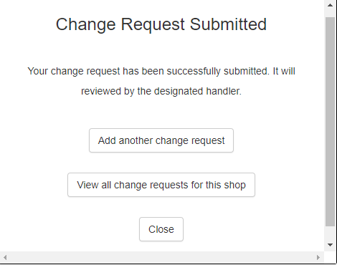
<number>
Submitting New CR
Notes:
To create an appeal, a user would click on "add" in the Chameleon shop view widget (this does require that you are using Chameleon shop views for client shop views) .
The user can choose from any available questions and can add text for the appeal.

Slide 8
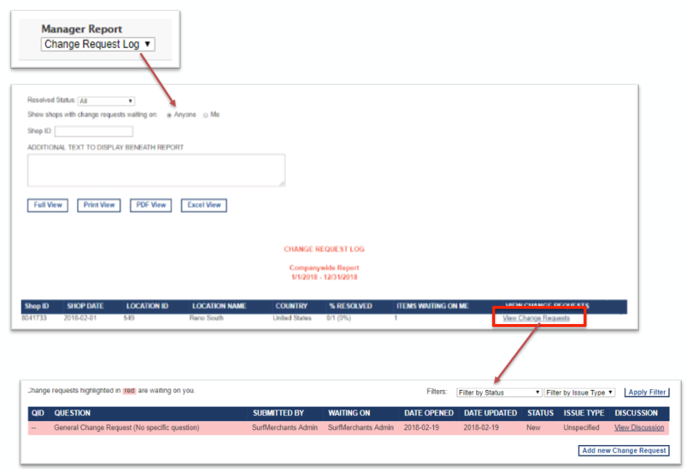
<number>
Reviewing CRs
Notes:
Once some appeals are created, they can be viewed in the "Classic Report" named Change Request Log.

Slide 9
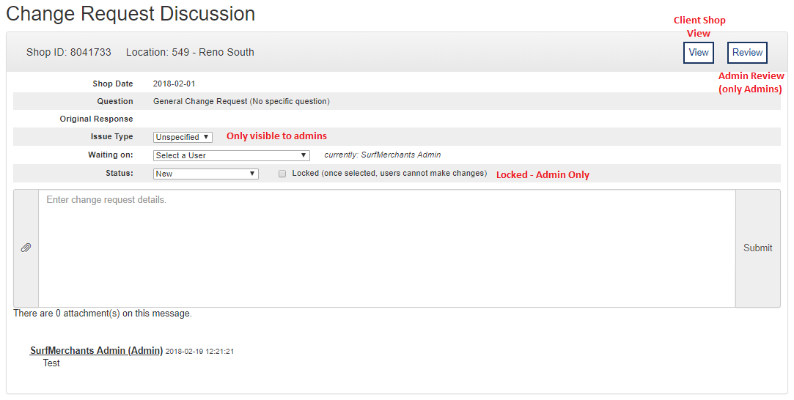
<number>
Reviewing CRs
Discussion
Notes:
The initial owner, or others with access to view the appeals, can view the requests and add comments.
Admins have an option to lock a change request to prevent any further comments or changes.

Slide 10
<number>
Please let Us Know If You Have Any Questions

